Slide 1

Software Testing at CMED Health Ltd.
Supervised By:
Dr. Farhana Sarkar
Assistant professor and Course Coordinator
Department of Computer Science and Engineering
University of Liberal Arts Bangladesh
Presented By:
Md Borhan Siddik
ID: 151014024
Department of Computer Science and Engineering
Notes:
Slide 1

Slide 2



CMED Health Limited is a startup Health-tech company concentrating on preventive healthcare established in 2016. CMED has a smart health observing framework for regular health monitoring. They utilize their FDA approved smart clinical sensors in association with smartphones for the estimation of vital signs and store information to its secured cloud server.
Their vision is to create a world where everyone has access to preventive healthcare.
CMED’s mission is to accurately assess the vitals of people’s health over time, in the environments where they live, work and play so they can reduce health risk, live more healthy & productive lives. Consequently, CMED will minimize peoples suffering & the overall mortality rate from noncommunicable diseases.
Company Profile
Vision
Mission
Notes:
Slide 3

Slide 3










Primary Health
Monitoring
Workforce Wellness
Program
Students Health &
Wellness program
Family Health &
Wellness Program
Color Coded
Intelligent Health Status
Cloud Based
Record System
Initial Health
Consultation
Result Based
Suggestion
CMED App Customization
Service
CMED E-Prescription
CMED Services
Notes:
Slide 4

Slide 4
My Duties And Responsibilities
Software Testing under the Test Team
Proper documentation of Issues and Bugs
Collaboration with other Testers and Developers
Suggesting new features or enhancements if needed
Testing API for data validation and import using Swagger UI
Project Assigned for Testing:
Corporate Agent Mobile & Web Application
Employee health screening of enlisted companies where registered
agents can take measurements of the employees from the mobile application
and the statistical results are automatically generated and synchronized
with the web dashboard.
CMED User Application
Registered users are able know their vitals by taking measurement through the CMED
smart IOT devices and download health report for further instruction from the doctor.
Notes:
Slide 5

Slide 5
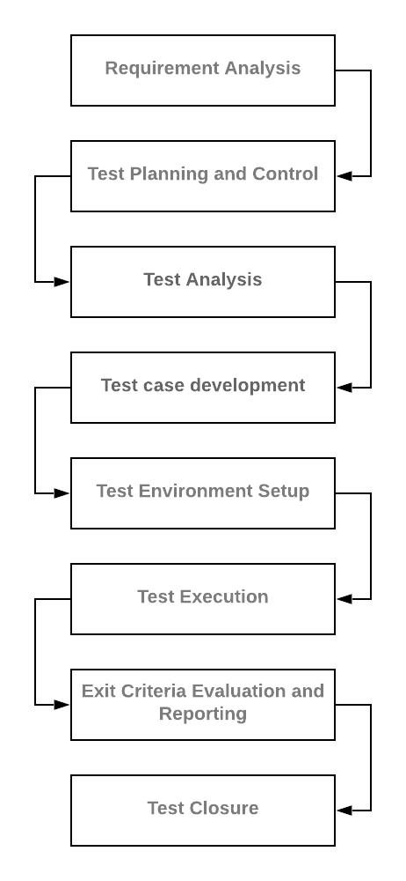
Software Testing For Quality Control
In basic terms, Software Testing implies Verification of Application Under Test (AUT).
Software testing can provide objective, independent information about the quality of software and risk of its failure to users or sponsors.
Activities performed during a
testing of software products
Basically Testing can be done in two ways
Automation Testing
-Using automated testing tools
Manual Testing
-Executing test cases manually without using any automated tool
Manual testing is essential because one of the software testing fundamentals which describes "100% automation is not possible“.
Since this approach is encouraged at CMED, in my projects I mostly followed manual testing approach as well as some automations.
Notes:
Slide 6

Slide 6
Internship Activities
Analyzed the project requirements and app functions thoroughly under the test team
Wrote basic documentation for test cases that can be understood and executed by any team
Executed Test cases to find out system defects and bugs
Worked as a bridge for communication between Design Team and Development Team to make sure the systems are developed according to the design.
Worked with Back End Team to cross check data validation and synchronization through mobile and web application as well as API through Swagger UI
Involved with other CMED projects like Tottho Apa, Help Age and PKSF’s Enriched Sastho to ensure the quality is consistent throughout the whole team.
For evaluation and reporting, traced all the issues, bugs and features in a formal manner using Trello and Redmine project Tracker for the convenient of other team members.
Notes:
Slide 7

Slide 7
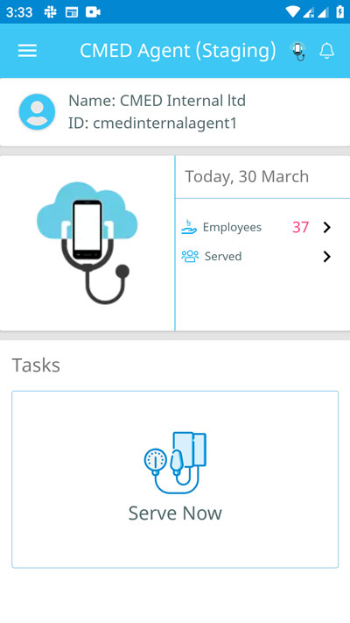
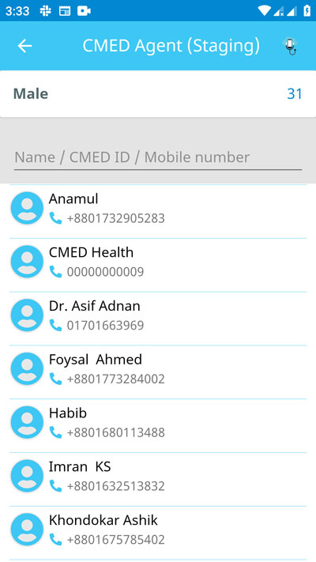
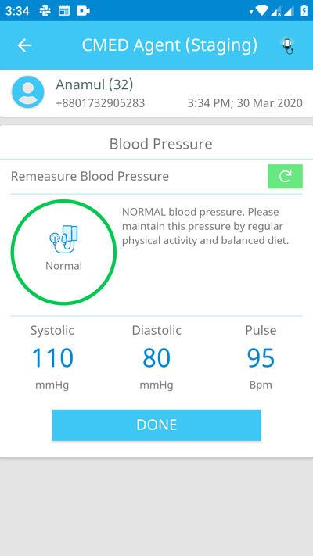
CMED Corporate Agent App
Home Page of the
logged in agent
List of male employees that
can be screened
Health status shown after
a measurement is taken
Notes:
Slide 8

Slide 8
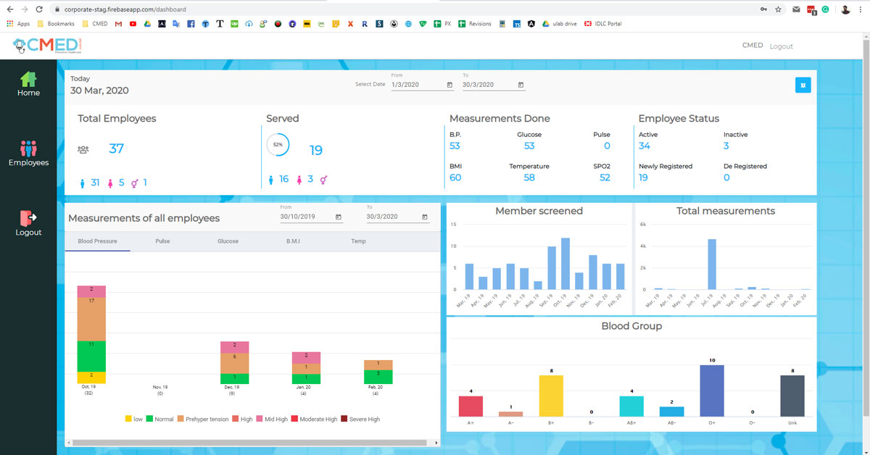
CMED Corporate Web Dashboard
Health Statistics for the all the employees under
the company that are recorded from agent app
Notes:
Slide 9

Slide 9
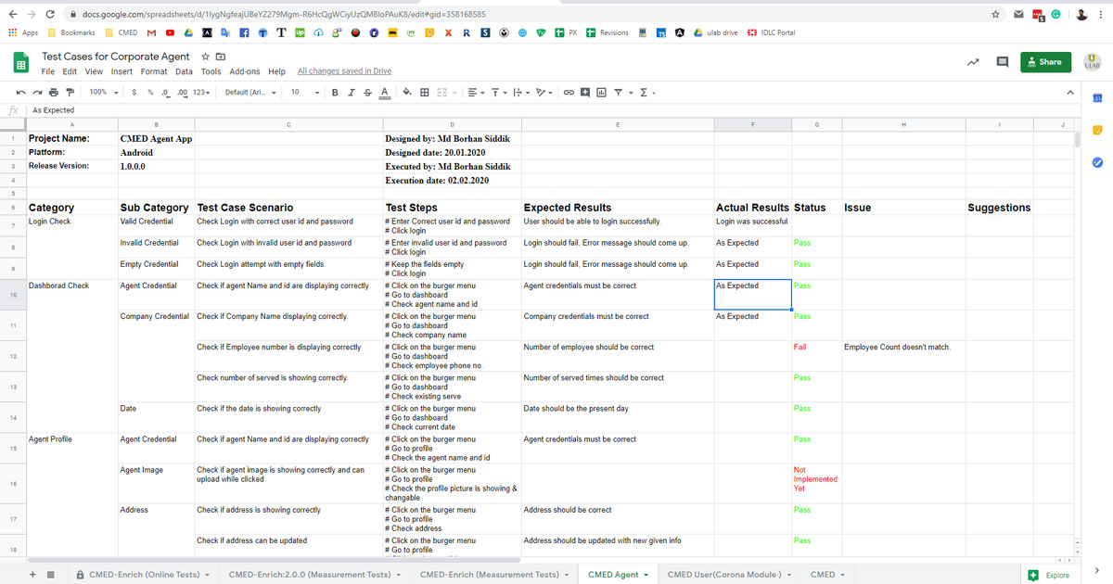
Documentation of Test Cases for Corporate Agent
Notes:
Slide 10

Slide 10
Tool Used
For real time measurement checking: CMED’s FDA approved smart measurement devices. (These devices can take vital measurements by connecting via the mobile phone using the CMED applications)
Used Slack for internal communications, tracking attendance, daily target announcement etc.
Project Trackers:
Redmine: CMED utilizes the renowned and widely used project tracker, Redmine. Used this project tracker to track issues, feature, support or enhancements.
Trello: Another paid project tracker used by CMED. Used this project tracker to immediately recognize and solve an issue like a blocker that blocking the applications.
Swagger UI: Used Swagger UI to match data between data coming from the APIs and applications. Also learned how to import data through REST APIs to app databases.
Notes:
Slide 11

Slide 11
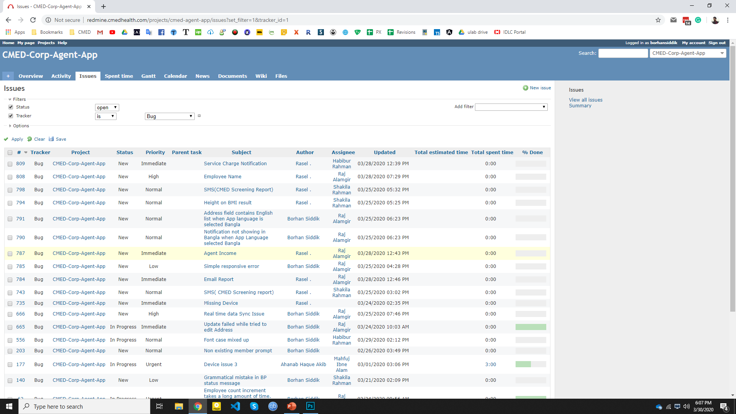
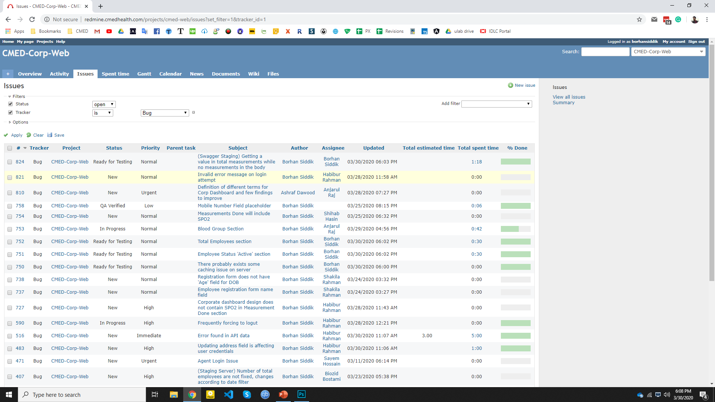
Project Tracker: Redmine
Issues tracked for Agent App
Issues tracked for Corporate web
Notes:
Slide 12

Slide 12
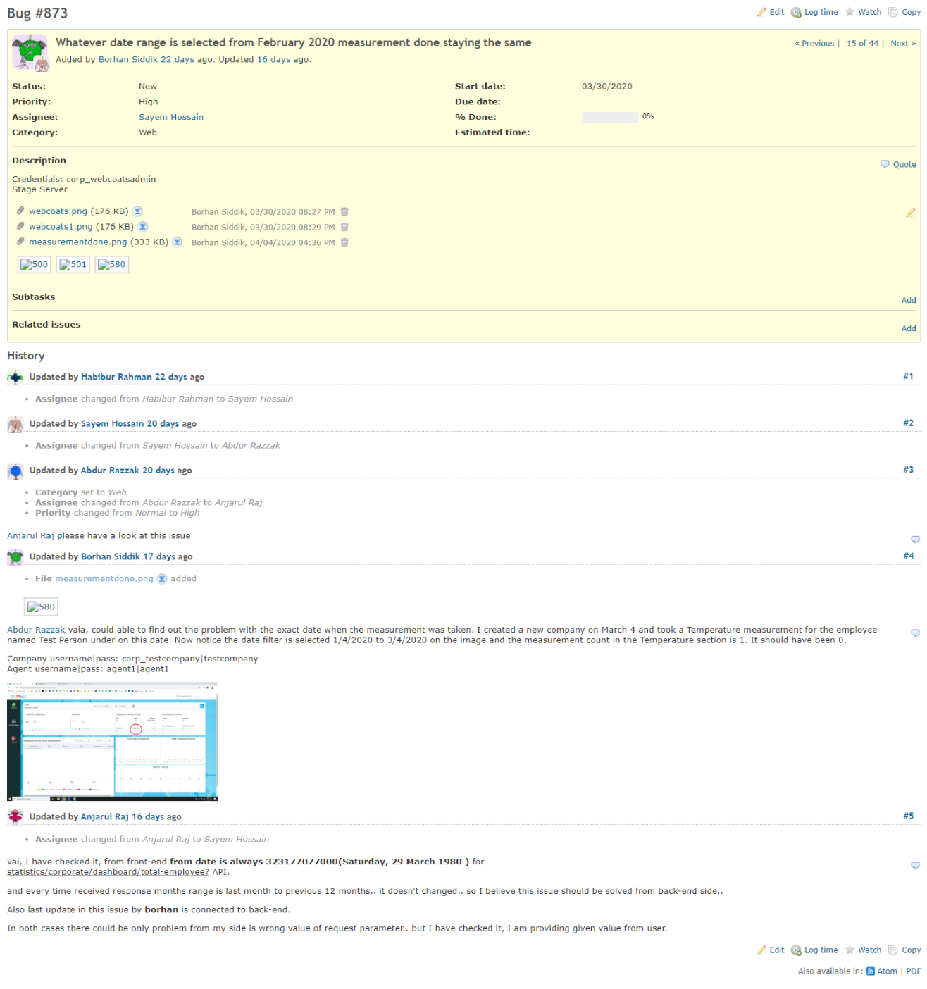
Inside a High priority
Bug and it’s conversation
to the approach of
Solving it

Slide 13
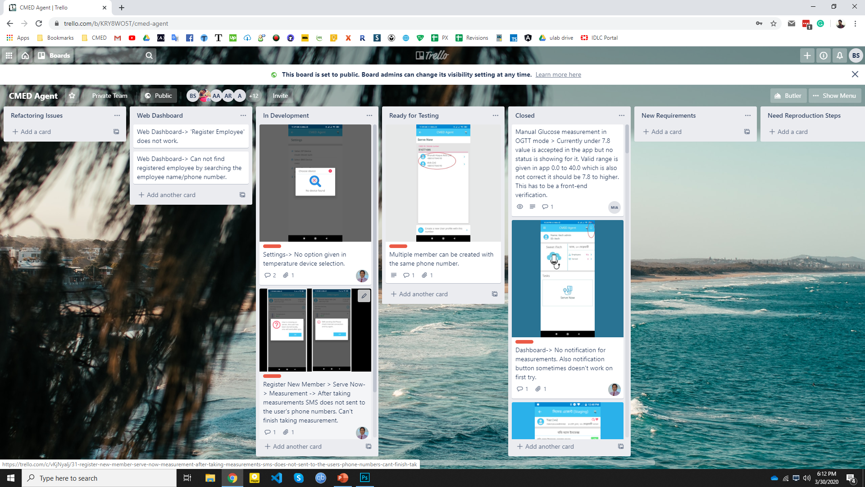
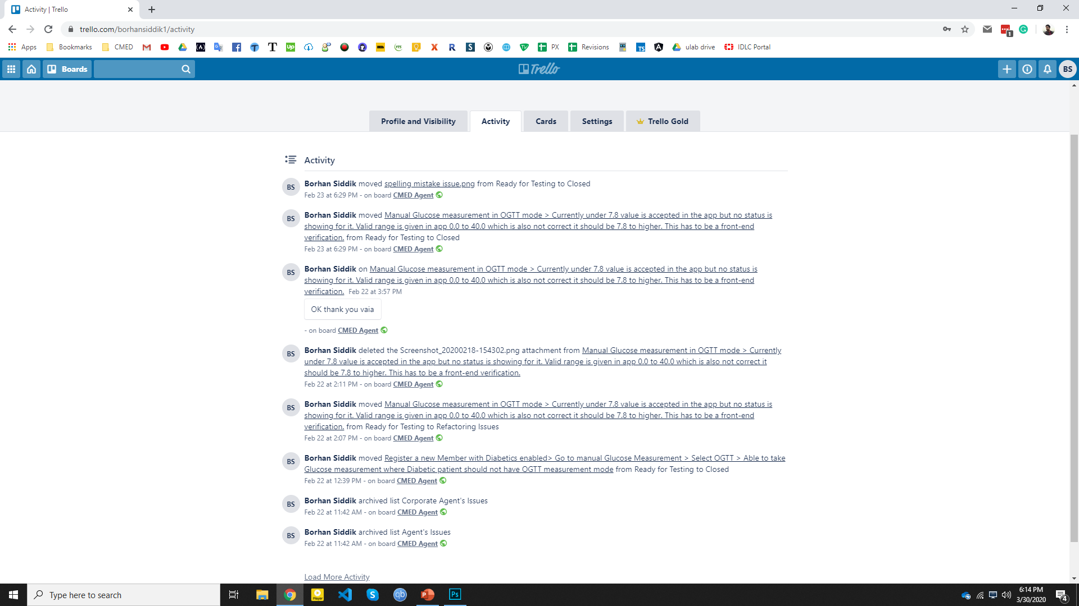
Project Tracker: Trello
Issues tracked in Trello card by card
Notes:
Slide 13

Slide 14
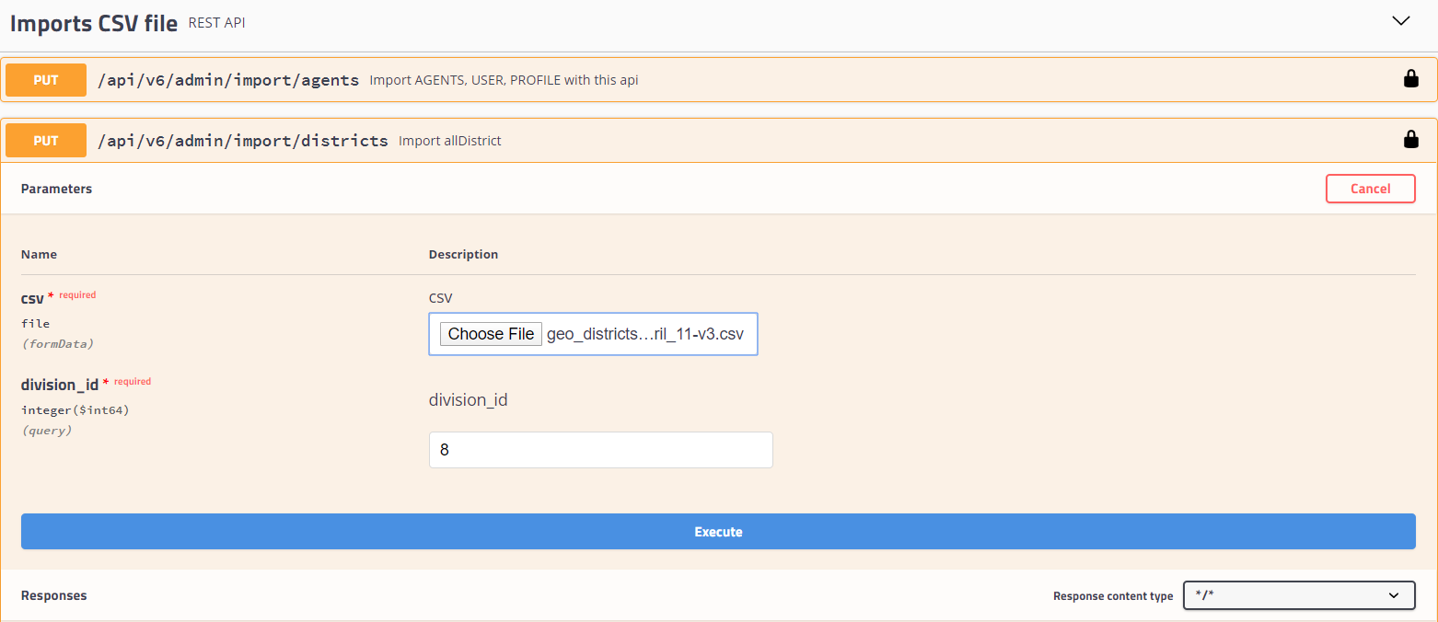
CRUD Operations with Swagger UI
Using Import API to upload district data

Slide 15
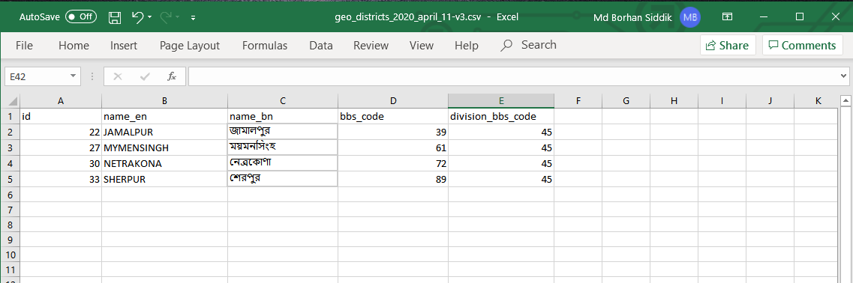
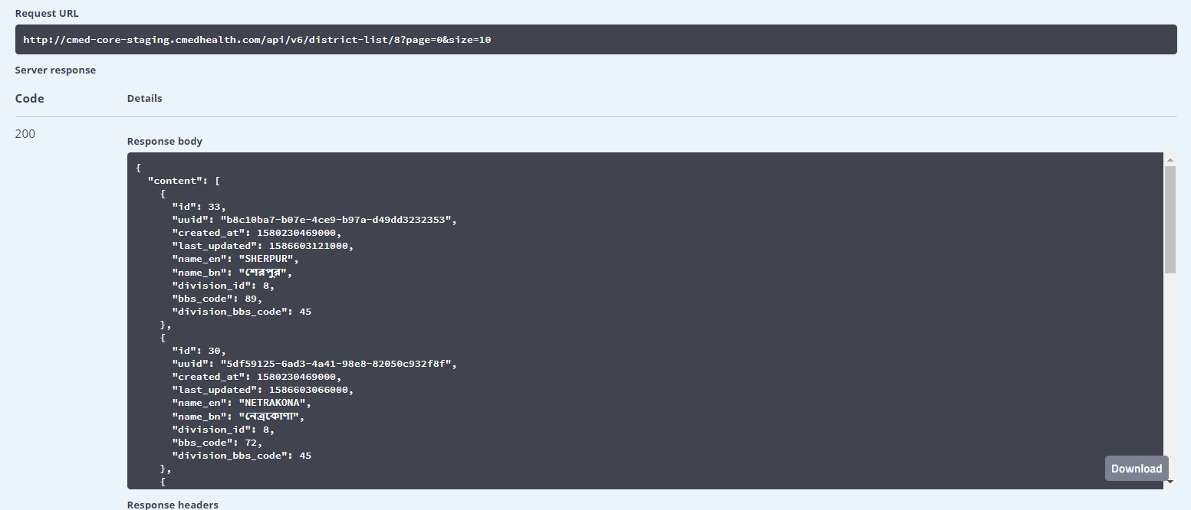
CRUD Operations with Swagger UI
CSV file to that goes into
the Import API
After successful import
Checking data to ensure

Slide 16
Thank You
Notes:
Slide 14

